Slide 1
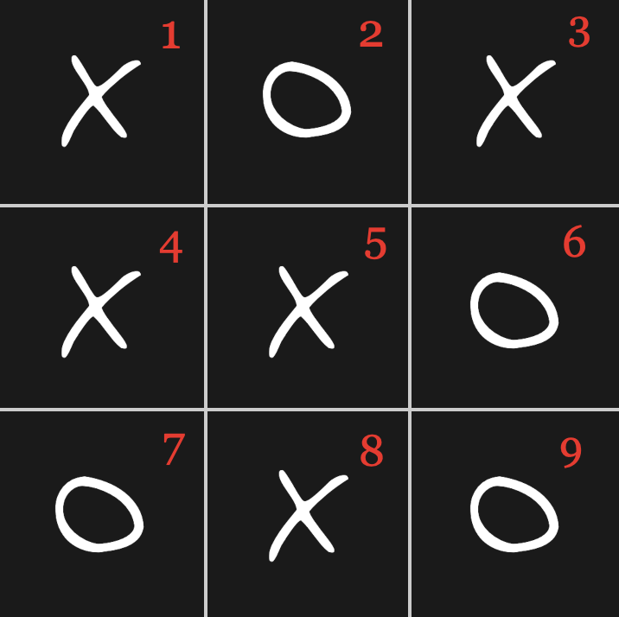


Tic Tac Toe
Dev Chakraborty

Slide 2
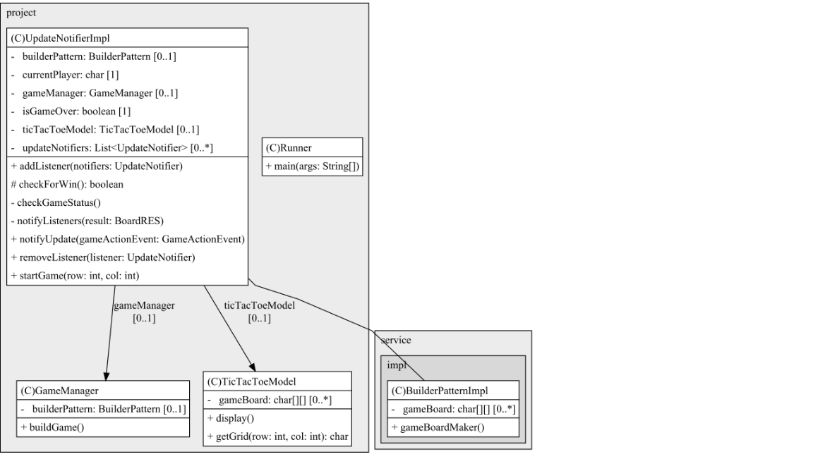
UML

Slide 3


The Software Design Pattern used are
Builder Pattern
Observer Pattern
Data Transfer Object (DTO)

Slide 4

Builder Pattern
BoardRES
1.Builder Pattern: a design pattern designed to provide a flexible solution to various object creation problems in object-oriented programming.
2.Observer Pattern: Used when there is one-to-many relationship between objects such as if one object is modified, its dependent objects are to be notified automatically.
3.DTO :This object carries data between processes. In the context of your Tic Tac Toe game, it carries information about whether a game has been won or resulted in a draw. This is used to transfer state information during notifications.

Slide 5
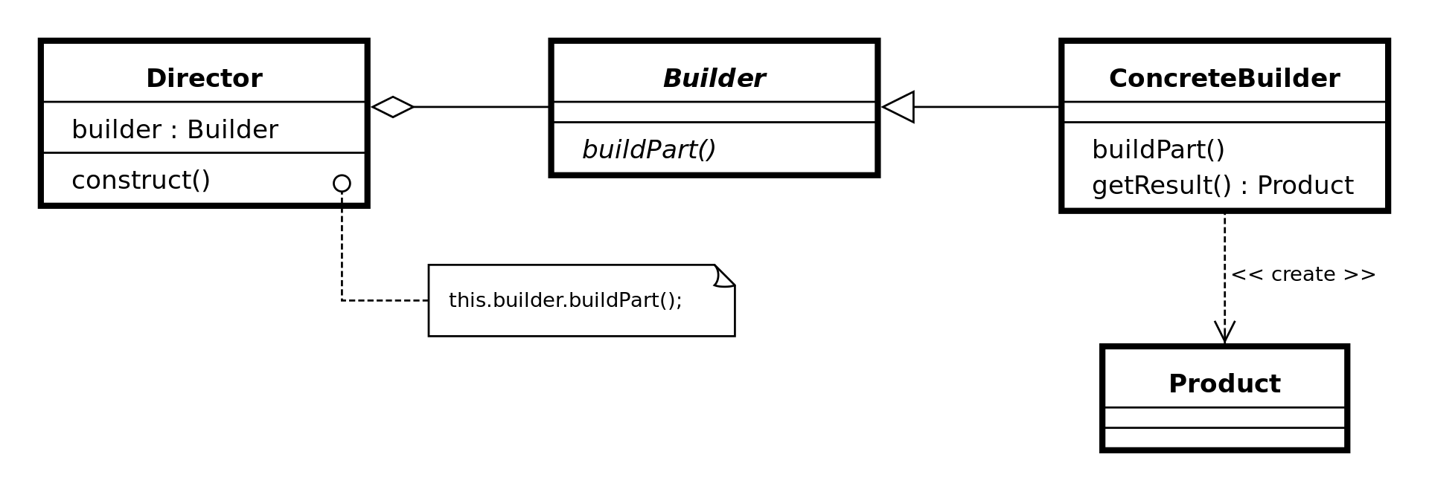
Builder pattern
Source: https://en.wikipedia.org/wiki/Builder_pattern

Slide 6
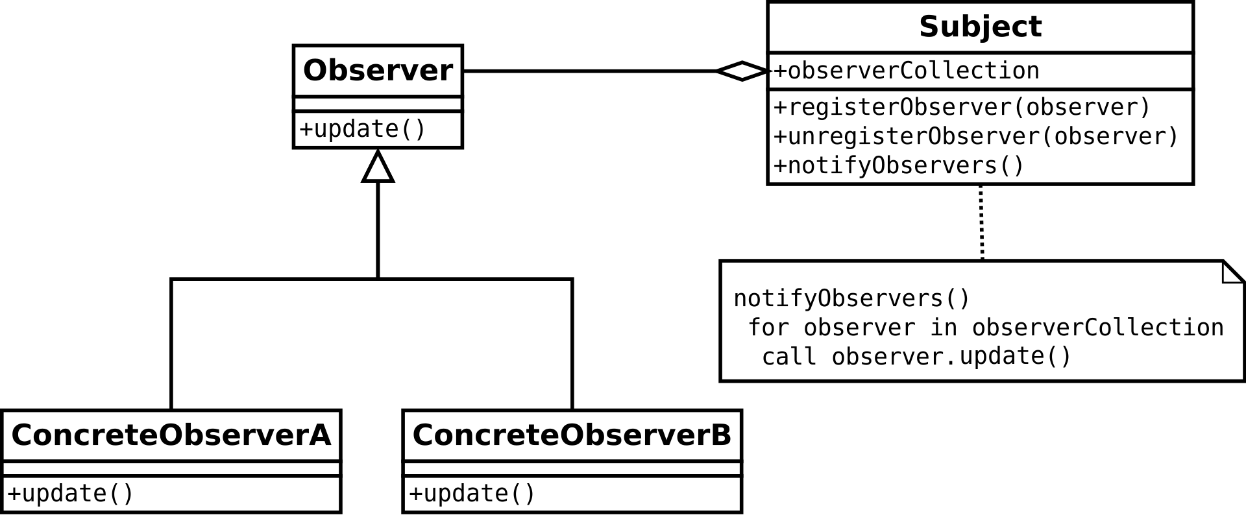
Observer Pattern
Source: https://en.wikipedia.org/wiki/Observer_pattern#/media/File:Observer_w_update.svg

Slide 7
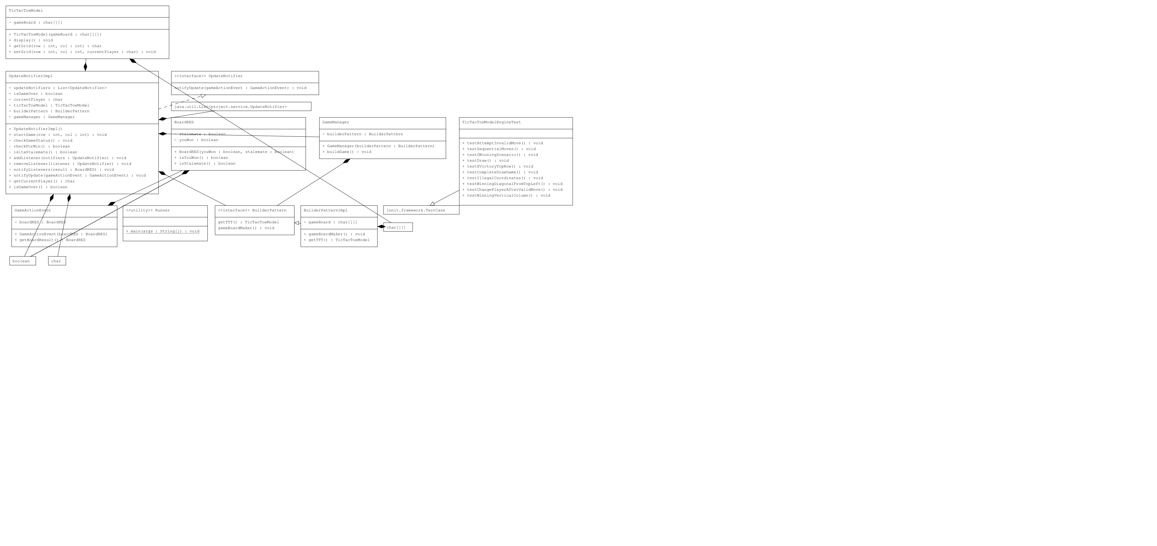
UML zoom in

